Slide 1

MS SQL 2012 Database Administration Training by Sholla Corporation
8204 Fenton Street
Silver Spring, MD 20910

Slide 2
MS-SQL 2012 Database Administrator
Course Content :
Part I. Introduction to Computers, Networking and Windows Admin
Introduction to Computer Basics
Introduction to Networking

Slide 3
MS-SQL 2012 Database …
Course Content :
Part II. MS SQL Database Design, Development and Administration
Introduction to Relational Database Management System
T-SQL Programming
SQL 2012 Features and Installation
SQL Server 2012 Administrative Tools
MS SQL Systems and user Defined Database
Data Files and Indexing
Securing SQL Server 2012
SQL Server 2012 Performance Tuning
Data Protection, High Availability and Disaster Recovery
Moving Database
MS SQL Job Agent
Introduction to SSRS & SSBI
Project
Part III. Job Placement Preparation, and Mentoring

Slide 4
MS-SQL 2012 Database Administrator
Part I

Slide 5
MS-SQL 2012 Database …
Part I. Introduction to Computers, Networking and Windows Admin
Introduction to Computer Basics:
Components of any computer (Hardware parts)
Computer software's (OS and application)
Data representation & unit of measurements
File system managements
Types of computers
Major parts to consider during purchasing a computer

Slide 6
Introduction to computer basics
Computers are machines that perform tasks or calculations according to a set of instructions, or programs.
Computers play a major role in our daily lives
Computers work through an interaction of hardware and software.
Hardware refers to the components of a computer that you can see and touch, including the case and everything inside it
Software is an instruction or program that executes some jobs when it runs on a computer
Two type ➔ OS and application
Notes:
A computer is an electronic device used to store and process information. It plays a major role in our lives. You use computers in education and research; broadcasting news, maintaining official and personal records; making weather forecasts, and for various other business and recreation activities.
By using computers, we save a lot of time, effort, and money.
After completing lesson 1, you will be able to:
Describe the importance of computers in today’s world.
Identify the main parts of a computer ➔ HW/SW …

Slide 7
Introduction to computer ….
Hardware components/parts of a computer
Input Devices (Keyboard, Mouse, webcam, scanner, mic)
Output Devices (Monitor, Speakers, etc.)
Central Processing Unit (CPU) and memory
Motherboard (Circuit Board)
Expansion Cards (Video Card, Sound Card, or NIC)
Hard Drive Ports and Connections (USB, Firewire, etc.)

Slide 8

Hardware Parts of a computer
Central Processing Unit (CPU)
A device that interprets and runs the commands that you give to the computer.
Also referred to as the processor or microprocessor
CPU is often referred to as the brain of the computer
Major brands of commercialized processors ➔intel, AMD, ARM
The Latest intel processor logo
Memory
Memory is where information is stored and retrieved by the CPU.
There are two main types of memory:
Random Access Memory (RAM) & Read Only Memory (ROM)
Notes:
Alternately referred to as a processor, central processor, or microprocessor, the CPU (pronounced sea-pea-you) is the Central Processing Unit of the computer. A computer's CPU handles all instructions it receives from hardware and software running on the computer
Random Access Memory (RAM): It is the main memory and allows you to temporarily store commands and data.
Read Only Memory (ROM): It is the memory that retains its contents even after the computer is turned off.

Slide 9
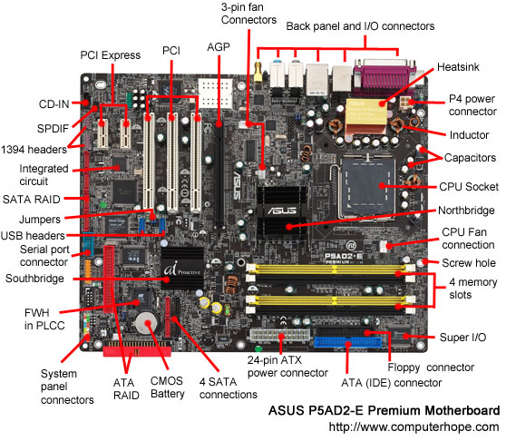

Hardware Parts of a computer ….
Mother board
Is the main circuit board inside the computer
Has tiny electronic circuits and other components on it
Connects input, output, and processing devices together
(CPU, Memory, Hard Drive, DVD Drive)
Expansion Cards
Video Card – is connected to the computer monitor and is used to display information on the monitor.
Network interface card
Notes:
The motherboard is a printed circuit board that is the foundation of a computer, located at the bottom of the computer case. It allocates power to the CPU, RAM, and all other computer hardware components. Most importantly, the motherboard allows hardware components to communicate with one another.
The picture above is the ASUS P5AD2-E motherboard with names of each major component of the motherboard. Clicking on the image below gives you a larger more detailed version of the picture below.

Slide 10

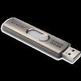


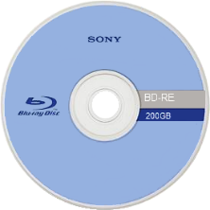
Hardware Parts of a computer ….
Storage Devices
Hard Disk
Flash Drive
CD-ROM
DVD-ROM
BD-RE
Front of an experimental 200 GB rewritable Blu-ray Disc
Note:
current optical disc technologies such as DVD, DVD±R, DVD±RW, and DVD-RAM rely on a red laser to read and write data, the new format uses a blue-violet laser instead, hence the name Blu-ray.
Notes:
You use storage devices to store computer information. Storage devices come in many forms. Some examples are hard drive or disk, CD-ROM, floppy disk, and DVD-ROM. Storage devices can be divided into two types, internal storage devices and external storage devices. Some common storage devices are described in the following list.
While current optical disc technologies such as DVD, DVD±R, DVD±RW, and DVD-RAM rely on a red laser to read and write data, the new format uses a blue-violet laser instead, hence the name Blu-ray. Despite the different type of lasers used, Blu-ray products can easily be made backwards compatible with CDs and DVDs through the use of a BD/DVD/CD compatible optical pickup unit.
Blu-ray Discs to hold 25GB/50GB. Recent development by Pioneer has pushed the storage capacity to 500GB on a single disc by using 20 layers.

Slide 11
Computer Software's
1. Operating Systems:
Is the most important software on the computer
Controls and manages the hardware connected to your computer
Provides an interface that helps you to interact with the computer
Ensures that your computer is functioning properly
Windows XP, 7, 8, 10 and Unix are examples of the operation system.
Can be either text-based or graphics-based.
Application Programs: there are many types of programs
Some programs allow you to perform tasks such as writing letters, doing calculations, or sending e-mail messages.
Other programs allow you to create illustrations, play games, watch movies, or communicate with other computer users.
Notes:
The hardware and the operating system together are referred to as a platform. Programs, also called applications, use this platform to perform tasks. There are many types of programs. Some programs allow you to perform tasks such as writing letters, doing calculations, or sending e-mail messages. For example, a word processor, such as Microsoft® Office Word 2010/2016, is a program that helps you create a letter.
Other programs allow you to create illustrations, play games, watch movies, or communicate with other computer users.

Slide 12
Data Representation: Unit of Measurement
Programs process data that you provide as input to your computer
Data can be in the form of text, graphics, audio, or video depending on the type of program
Program processes the data and displays the output on the screen. You can save this output in a file.
What units of measurement are used for data storage?
The smallest unit of measurement used for measuring data is a bit
A single bit can have a value of either 0 or 1
It may contain a binary value (such as On/Off or True/False)
a byte, or eight bits, is used as the fundamental unit of measurement for data. A byte can store 2⁸ or 256 different values, which is sufficient to represent standard ASCII characters
Notes:
A byte can store 2⁸ or 256 different values, which is sufficient to represent standard ASCII characters, such as letters, numbers and symbols.
Since most files contain thousands of bytes, file sizes are often measured in kilobytes. Larger files, such as images, videos, and audio files, contain millions of bytes and therefore are measured in megabytes. Modern storage devices can store thousands of these files, which is why storage capacity is typically measured in gigabytes or even terabytes. Larger units of measurement are usually reserved for measuring the sum of multiple storage devices or the capacity of large data storage networks.

Slide 13
List of all the standard units of measurement used for data storage
Unit | Value | Size
bit (b) | 0 or 1 | 1/8 of a byte
byte (B) | 8 bits | 1 byte
kilobyte (KB) | 1000¹ bytes | 1,000 bytes
megabyte (MB) | 1000² bytes | 1,000,000 bytes
gigabyte (GB) | 1000³ bytes | 1,000,000,000 bytes
terabyte (TB) | 1000⁴ bytes | 1,000,000,000,000 bytes
petabyte (PB) | 1000⁵ bytes | 1,000,000,000,000,000 bytes
exabyte (EB) | 1000⁶ bytes | 1,000,000,000,000,000,000 bytes
zettabyte (ZB) | 1000⁷ bytes | 1,000,000,000,000,000,000,000 bytes
Notes:
NOTE: A lowercase "b" is used as an abbreviation for bits, while an uppercase "B" represents bytes. This is an important distinction, since a byte is 8x as large as a bit.
For example, 100 KB (kilobytes) = 800 Kb (kilobits).

Slide 14
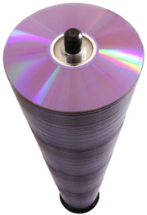

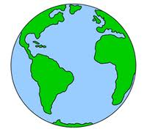
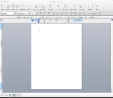


Computer Software's
One page
of text
One song
One movie
6 million
books
55 storeys
of DVD
Data
up to
2003
Data
in 2011
30KB
5 MB
5 GB
1 TB
1 PB
1.8 ZB
5 EB
Who has this data size ???
Byte Kilobyte Megabyte Gigabyte Terabyte Petabyte Exabyte Zettabyte Yottabyte
KB MB GB TB PB EB ZB YB
1000 bytes 1000 KB 1000 MB 1000 GB 1000 TB 1000 PB 1000 ZB 1000YB
1s 20 mins 11 days 30 years 300 30 million 30 billion ….
centuries years years

Slide 15
File system management
A file system (sometimes written filesystem) is the way in which files are named and where they are placed logically for storage and retrieval
All OS have file systems in which files are placed somewhere in a hierarchical form called tree structure
Files are placed at leaves in a tree structured directory system
E.g: Root Directory/Directory/sub-directory/…/ file
Notes:
DOS, Windows, OS/2, Macintosh and Unix-based operating systems (OSes) all have file systems in which files are placed somewhere in a hierarchical (tree) structure. A file is placed in a directory (folder in Windows) or subdirectory at the desired place in the tree structure.
A tree structure is an algorithm for placing and locating files (called records or keys) in a database. The algorithm finds data by repeatedly making choices at decision points called nodes. A node can have as few as two branches (also called children), or as many as several dozen.

Slide 16
Types of Computers
Supercomputers:
The highly calculation-intensive tasks can be effectively performed by means of supercomputers. Quantum physics, mechanics, weather forecasting, molecular theory are best studied by means of supercomputers.
Mainframe Computers:
Large organizations use mainframes for highly critical applications such as bulk data processing and ERP. Most of the mainframe computers have capacity to host multiple operating systems
Microcomputers:
A computer with a microprocessor and its central processing unit is known as a microcomputer.
Personal computers
Desktops:
Laptops:
Personal Digital Assistants (PDAs):
Notes:
Microcomputers: A computer with a microprocessor and its central processing unit is known as a microcomputer. They do not occupy space as much as mainframes. When supplemented with a keyboard and a mouse, microcomputers can be called as personal computers. A monitor, a keyboard and other similar input output devices, computer memory in the form of RAM and a power supply unit come packaged in a microcomputer. These computers can fit on desks or tables and serve as the best choices for single-user tasks.

Slide 17
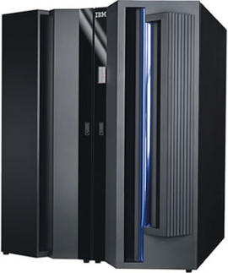
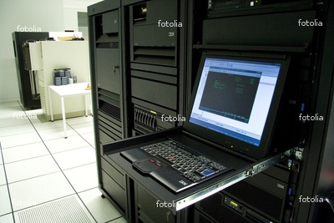
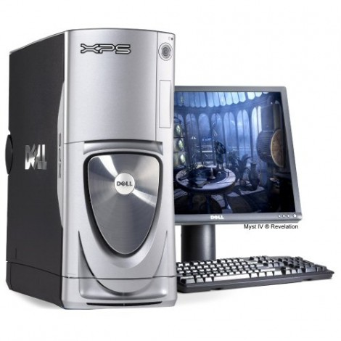
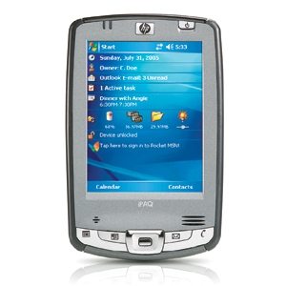
Types of Computers

Slide 18
Major parts to consider during purchasing a computer
Before you decide purchasing a computer:
Know your requirements and purpose
Does your requirement need high graphics?
Do you carry it and travel long distance?
How much do you want to invest?
Battery
First:
Processor speed, type and its version
Memory
Disc storage size or screen size
Second:
Weight
Battery power
Available ports and DVD/BD type

